Slide 1
2022F-T3 BDM 3203 – Hadoop Ecosystem for Big Data 01(DSMM)
Uber Big Data Case Study
Group – A
Roshan Acharya
Aadarsha Chapagain(C0825975)
Anjana Kuriakose
Onyinye Mbanefo

Slide 2
Contents
Introduction
Challenges
Data at its core
Historical Data
Business Case
Architecture
Solutions
Result
Working Mechanism
Data Again
Conclusion

Slide 3
Introduction
With more than 8 million users, 1 billion Uber trips and 160,000+ people driving for Uber across 449 cities in 66 countries – Uber is the fastest growing startup standing at the top of its game. Tackling problems like poor transportation infrastructure in some cities, unsatisfactory customer experience, late cars, poor fulfilment, drivers denying to accept credit cards and more –Uber has “eaten the world” in less than 5 years and is a remarkable name to reckon when it comes to solving problems for people in transportation

Slide 4
Challenges
Although it may seem pretty straight forward from users end there are lots of challenges faced:
Surge pricing, better cars,
Detecting fake rides, fake cards, fake ratings,
Estimating fares
Driver ratings.

Slide 5
Data at its core
Uber lives or dies by data
The more data they can collect, the more information they can derive from patterns and behaviors
“The ability to increase profit is based on data analysis”-Spencer Former uber driver

Slide 6
Historical data
Collects data with many cheap relative storage options like Hadoop and Spark
Uber has got data about every single GPS point for every trip taken on Uber
Stores Historic information about its system and capabilities which will ease doing data science for its data scientists down the road
Based on the historical data scientist will be able to answer. What did the Uber system look like at a particular point of time?
From a customer perspective
Supply behavior perspective,
From inter-server communication perspective or even to the state of a database

Slide 7
Business case
No need to look for a local taxi or to tip a bellman for the ride
Click away from high quality customer service possible with Uber’s revolutionizing data driven business model
Data is the biggest asset for Uber and the whole business model is based on crowd sourcing
Anybody with a car willing to help someone get to a desired location can offer help in getting them there

Slide 8
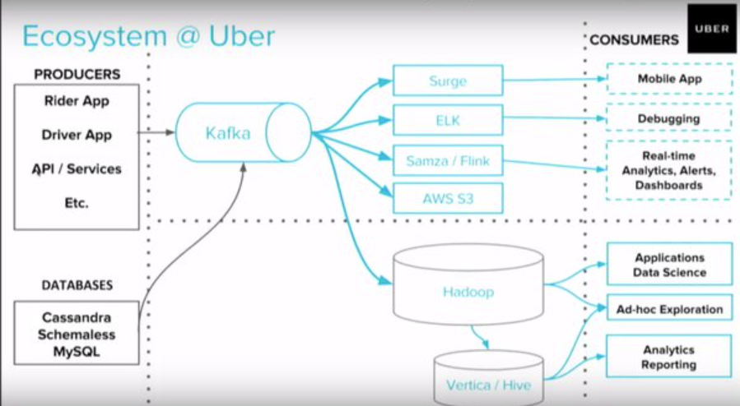
Architecture
Uber’s data is collected in a Hadoop data lake and it uses spark and hadoop to process the data. Uber’s data comes from a range of data types and databases like SOA database tables, schema less data stores and the event messaging system, Apache Kafka

Slide 9
Working Mechanism
Match a user with the most suitable driver within a 15 second window to the nearest driver
Stores and analyses data on every single trip the users take which is leveraged to predict the demand for cars, set the fares and allocate sufficient resources
Performs in-depth analysis of the public transport networks across different cities so that they can focus on cities that have poor transportation and make the best use of the data to enhance customer service experience.

Slide 10
Data Again
Uber drivers continue to generate data for Uber even when they are not carrying any passengers.
Data is transmitted back to the central platform at Uber which is used to draw inferences on traffic patterns.
The data is stored into the database for supply and demand algorithm analysis
Driver data is used for autonomous car research, surge pricing, tracking the location of drivers, monitoring driver’s speed, motion and acceleration and identifying if a driver is working for a competing cab sharing company.

Slide 11
Conclusion
“Whether it’s calculating Uber’s “surge pricing, “helping drivers to avoid accidents, or finding the optimal positioning of cars to maximize profits, data is central to what Uber does. All these data problems are really crystalized on this one math with people all over the world trying to get where they want to go. That’s made data extremely exciting here, it’s made engaging with Spark extremely exciting.”- said Uber’s Head of Data Aaron Schildkrout.

Slide 12
References
https://www.projectpro.io/article/how-uber-uses-data-science-to-reinvent-transportation/290
https://www.slideshare.net/Maramaldawood/uber-case-study-231995516

